Slide 1
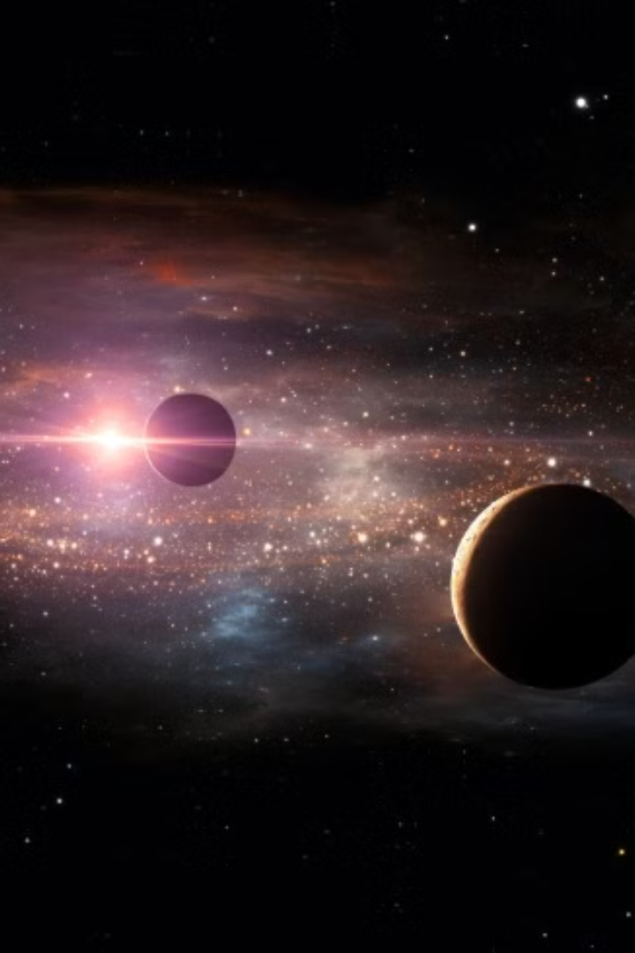

Chronicles of Exoplanet Exploration
Exoplanets are planets that orbit stars outside our solar system. These celestial bodies have revolutionized our understanding of the universe and sparked curiosity about the possibility of life beyond Earth. This presentation delves into the exciting world of exoplanet exploration.
An exoplanet is any planet beyond our solar system. Most of them orbit other stars, but some free-floating exoplanets, called rogue planets, are untethered to any star. We’ve confirmed more than 5,600 exoplanets out of the billions that we believe exist.
Notes:
Exoplanets are planets that orbit stars outside our solar system These distant worlds have transformed our understanding of the universe They have ignited our curiosity about the potential for life beyond Earth This presentation will take you on a journey through the exciting field of exoplanet exploration We'll uncover the latest discoveries, the cutting-edge technologies, and the tantalizing possibilities that these alien worlds hold

Slide 2
Exoplanet Atmospheres
Exoplanet atmospheres hold valuable clues about their formation, evolution, and potential habitability. Studying these atmospheres allows scientists to understand the composition, temperature, and pressure of these distant worlds. The presence of specific molecules, like water vapor, methane, or oxygen, can indicate the potential for life.

Slide 3
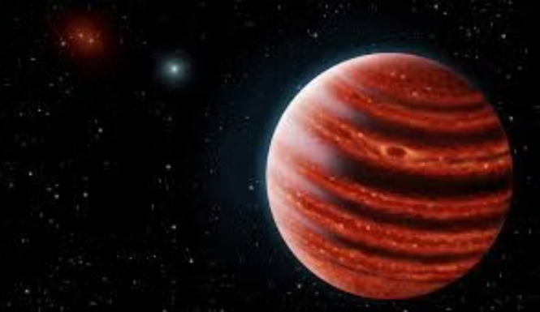
Exoplanet Facts
Exoplanets come in a vast array of sizes, compositions, and orbital configurations. Some are gas giants similar to Jupiter, while others are rocky and Earth-like.
Exoplanets are found in a variety of star systems, from single stars to multiple star systems. Some exoplanets orbit their stars closely, while others are located farther out.
Exoplanets offer valuable insights into planet formation, evolution, and the possibility of life beyond Earth. They are helping scientists to understand the diversity of planetary systems in our galaxy.

Slide 4
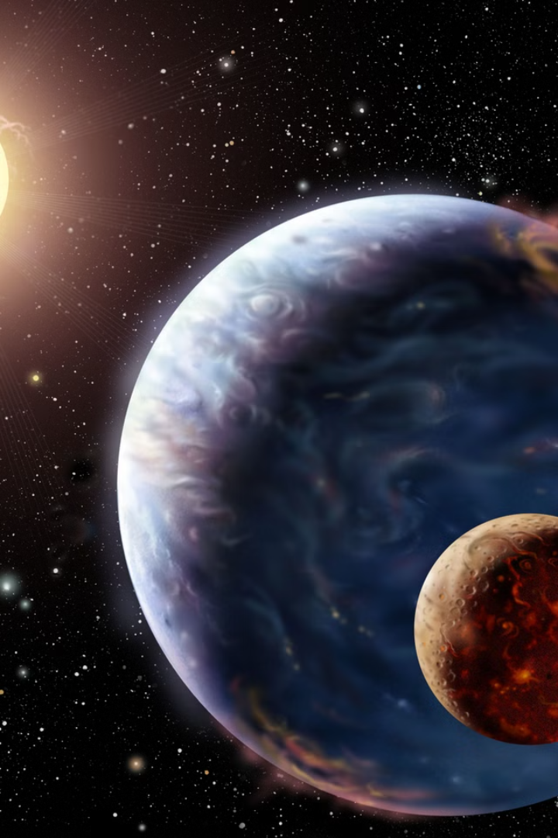
Exoplanets Facts
1
Diverse Environments
2
Extreme Conditions
Some exoplanets experience extreme temperatures, gravity, and atmospheric conditions.
Exoplanets exhibit a wide range of sizes, masses, and compositions.
3
Potential for Life
4
Expanding Universe
The discovery of exoplanets within habitable zones has fueled the search for extraterrestrial life.
Exoplanets have expanded our understanding of planetary formation and the diversity of solar systems.
Notes:
Exoplanets, or planets outside our solar system, exhibit a wide range of sizes, masses, and compositions, showcasing the incredible diversity of planetary environments in the universe. Many exoplanets experience extreme conditions, such as extreme temperatures, intense gravity, and inhospitable atmospheric conditions, pushing the boundaries of what we understand about planetary formation and evolution. The discovery of exoplanets within the habitable zones of their host stars has fueled the search for extraterrestrial life, as these planets may have the potential to support life as we know it. The study of exoplanets has expanded our understanding of how planetary systems form and evolve, revealing the incredible diversity of solar systems throughout the cosmos.

Slide 5
Stars in Exoplanet Systems
Spectral Types
Stellar Evolution
Stellar Activity
Exoplanet-hosting stars vary in spectral type, ranging from cool red dwarfs to hot blue giants.
The evolution of stars impacts the conditions of their planetary systems, including the habitable zone.
Stellar flares and coronal mass ejections can influence the atmospheres and habitability of exoplanets.
Notes:
Exoplanet-hosting stars come in a wide range of spectral types, from cool red dwarfs to hot blue giants The evolution of these stars over time impacts the conditions in their planetary systems, including the location of the habitable zone Stellar activity like flares and coronal mass ejections can significantly influence the atmospheres and overall habitability of exoplanets

Slide 6
Stars in Exoplanet Systems
Exoplanets orbit stars, providing insights into planetary formation and evolution.
Studying the properties of host stars helps us understand the conditions around exoplanets, including their habitability.
The characteristics of stars, like their spectral type, mass, and age, influence the types of exoplanets that form around them.
Spectral Types
Stars are classified by their spectral types, ranging from cool red dwarfs to hot blue giants.
The spectral type of a star determines its temperature, color, and luminosity.
Stellar Evolution
Stars evolve over time, changing their luminosity and size.
The evolution of a star can significantly impact the conditions in its planetary system.
Stellar Activity
Stars can exhibit activity like flares and coronal mass ejections, which can affect exoplanet atmospheres and habitability.
Understanding stellar activity is crucial for assessing the potential for life on exoplanets.

Slide 7
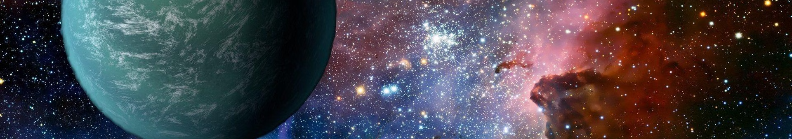
Types of Exoplanets
Gas Giants
Super-Earths
Similar to Jupiter and Saturn in our solar system, they are massive and composed primarily of gas.
Larger than Earth but smaller than gas giants, they are rocky planets with potentially diverse atmospheres.
Hot Jupiters
Mini-Neptunes
Gas giants that orbit very close to their stars, resulting in extreme temperatures and rapid orbital periods.
Smaller than Neptune but larger than Earth, they are thought to have substantial atmospheres and possible water.
Notes:
Gas giants are similar to Jupiter and Saturn in our solar system - they are massive and composed primarily of gas Super-Earths are larger than Earth but smaller than gas giants - they are rocky planets with potentially diverse atmospheres Hot Jupiters are gas giants that orbit very close to their stars, resulting in extreme temperatures and rapid orbital periods Mini-Neptunes are smaller than Neptune but larger than Earth - they are thought to have substantial atmospheres and possible water

Slide 8

Finding and Characterizing Exoplanets
1
Transit Method
Detects the slight dimming of a star's light as an exoplanet passes in front of it.
2
Radial Velocity Method
Measures the "wobble" of a star caused by the gravitational pull of an orbiting exoplanet.
3
Direct Imaging
Captures images of exoplanets directly, often using advanced telescopes and techniques.
4
Microlensing
Uses the gravitational lensing effect of a star to detect the presence of an exoplanet.
Notes:
The main focus of this slide is the different methods used to detect and characterize exoplanets, or planets orbiting other stars. The first method discussed is the transit method, which looks for the slight dimming of a star's light as an exoplanet passes in front of it. Next is the radial velocity method, which measures the "wobble" of a star caused by the gravitational pull of an orbiting exoplanet. Direct imaging is also covered, which involves capturing images of exoplanets directly using advanced telescopes and techniques. Finally, the microlensing method is explained, which uses the gravitational lensing effect of a star to detect the presence of an exoplanet. Each of these techniques provides valuable information about the properties and characteristics of exoplanets.

Slide 9
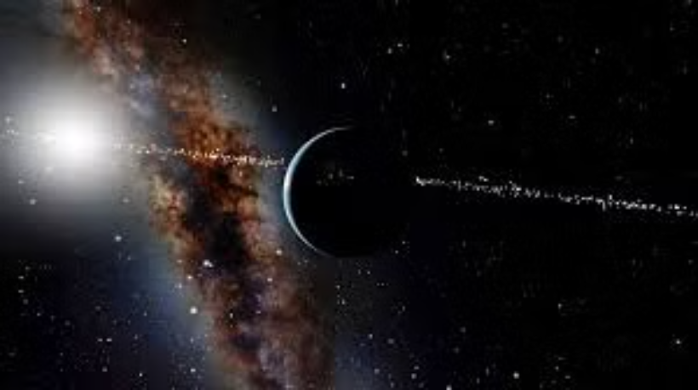
Exoplanet Habitability
Exoplanet habitability is a complex and challenging concept to define.
It's the potential for an exoplanet to support life, particularly life similar to Earth's.
Scientists consider factors such as distance from the star, temperature, water availability, and atmospheric composition when determining an exoplanet's habitability.

Slide 10



Universe
Cosmic Scale
Exoplanets are found in galaxies far beyond our own Milky Way, expanding our knowledge of the universe.
Interstellar Distances
The vast distances between stars make observing and characterizing exoplanets extremely challenging.
Cosmology
Exoplanets offer insights into the formation and evolution of galaxies and the origins of the universe.
Notes:
• The observable universe is vast, containing trillions of stars across billions of galaxies. • Exoplanets, or planets orbiting stars outside our solar system, have been discovered in distant galaxies, expanding our understanding of the cosmic scale. • The immense distances between stars make it extremely challenging to observe and study exoplanets, as the signals from these distant worlds are faint and difficult to detect. • Studying exoplanets provides valuable insights into the formation and evolution of galaxies, as well as the origins of the universe itself.

Slide 11

NASA's Exoplanet Exploration Program
Goal 1
To discover and characterize planets around other stars.
Goal 2
To understand the formation, evolution, and diversity of planetary systems.
Goal 3
To search for signs of life beyond Earth.

Slide 12





The Study of Exoplanets
Telescopic Observations
Data Analysis
Ground-based and space telescopes are used to observe exoplanets and their host stars.
Sophisticated algorithms and computer models are used to analyze data and interpret observations.
Theoretical Modeling
Collaboration
Researchers develop models to simulate the formation, evolution, and atmospheres of exoplanets.
Exoplanet research is a collaborative effort involving scientists from various disciplines.

Slide 13

Challenges in Exoplanet Exploration
1
Distance
2
Small Size
Exoplanets are extremely distant, making observations and data collection difficult.
Exoplanets are often small compared to their host stars, making them difficult to detect and characterize.
3
Atmospheric Characterization
4
Data Interpretation
Interpreting complex data from exoplanet observations requires sophisticated algorithms and models.
Determining the composition and properties of exoplanet atmospheres requires advanced techniques.

Slide 14


Future Research in Exoplanets
Advanced Telescopes
Robotic Missions
Next-generation telescopes with improved sensitivity and resolution will enable more detailed observations of exoplanets.
Robotic missions to exoplanets will provide close-up observations and potentially collect samples for analysis.

